Slide 1
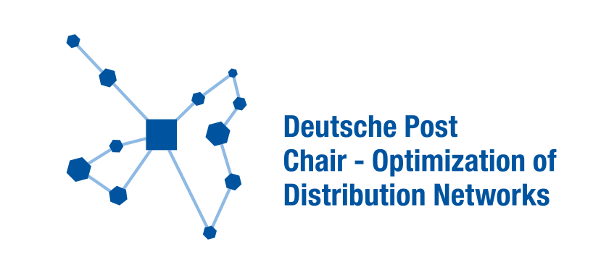












Sentiment analysis on IMDB film reviews
Constantin Gosten
Yulia Ott
Jiabo Zhang
Machine Learning and Data Analytics
Deutsche Post Chair – Optimization of Distribution Networks
RWTH Aachen University
Motivation
Methodology
Add your information, graphs and images to this section.
Add your information, graphs and images to this section.
Estimated amount of choices the average adult do everyday: 35.000
Small decisions: what do wear, eat, drink, use, purchase, believe …
Hard enough to keep track about own decisions.
Data Cleaning
TF IFD – Term frequency and inverse document frequency
Stemmatization
Lemmatization
Modelling
Dataset
Add your information, graphs and images to this section.
Results
Add your information, graphs and images to this section.
K-Means
Naive-Bayes Classifier + ROC Curve
50.000 IMDB film reviews
Sentiment analysis: postivie or negative
Training data: 37.500
Test data: 12.500
Next Steps
Add your information, graphs and images to this section.
Latent Dirichlet Allocation

